Slide 1
Data Warehousing and Data Mining
Unit 3
Data Preprocessing

Slide 2
Data Preprocessing
Why preprocess the data?
Data cleaning
Data integration and transformation

Slide 3
Why Data Preprocessing?
Data in the real world is dirty
incomplete: lacking attribute values, lacking certain attributes of interest, or containing only aggregate data
e.g., occupation=“ ”
noisy: containing errors or outliers
e.g., Salary=“-10”
inconsistent: containing discrepancies in codes or names
e.g., Age=“42” Birthday=“03/07/1997”
e.g., Was rating “1,2,3”, now rating “A, B, C”

Slide 4
Why Is Data Dirty?
Incomplete data may come from
“Not applicable” data value when collected
Different considerations between the time when the data was collected and when it is analyzed.
Human/hardware/software problems
Noisy data (incorrect values) may come from
Faulty data collection instruments
Human or computer error at data entry
Errors in data transmission
Inconsistent data may come from
Different data sources
Functional dependency violation (e.g., modify some linked data)
Duplicate records also need data cleaning

Slide 5
Why Is Data Preprocessing Important?
No quality data, no quality mining results!
Quality decisions must be based on quality data
e.g., duplicate or missing data may cause incorrect or even misleading statistics.
Data warehouse needs consistent integration of quality data
Data extraction, cleaning, and transformation comprises the majority of the work of building a data warehouse

Slide 6
Major Tasks in Data Preprocessing
Data cleaning
Fill in missing values, smooth noisy data, identify or remove outliers, and resolve inconsistencies
Data integration
Integration of multiple databases, data cubes, or files
Data transformation
Normalization and aggregation
Data reduction
Obtains reduced representation in volume but produces the same or similar analytical results
Data discretization
Part of data reduction but with particular importance, especially for numerical data

Slide 7
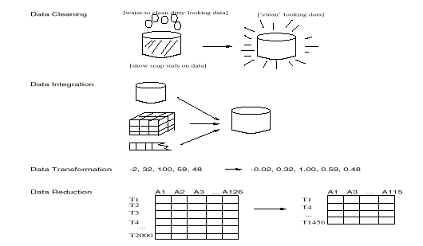
Form of Data Preprocessing

Slide 8
Data Cleaning
Importance
“Data cleaning is one of the three biggest problems in data warehousing”—Ralph Kimball
“Data cleaning is the number one problem in data warehousing”—DCI survey
Data cleaning tasks
Fill in missing values
Identify outliers and smooth out noisy data
Correct inconsistent data

Slide 9
Missing Data
Data is not always available
E.g., many tuples have no recorded value for several attributes, such as customer income in sales data
Missing data may be due to
equipment malfunction
inconsistent with other recorded data and thus deleted
data not entered due to misunderstanding
certain data may not be considered important at the time of entry
not register history or changes of the data
Missing data may need to be inferred.

Slide 10
How to Handle Missing Data?
Ignore the tuple: usually done when class label is missing (assuming the tasks in classification—not effective when the percentage of missing values per attribute varies considerably.
Fill in the missing value manually: tedious + infeasible?
Fill in it automatically with
a global constant : e.g., “unknown”, a new class?!
the attribute mean
the attribute mean for all samples belonging to the same class: smarter
Use the most probable value to fill in the missing value

Slide 11
Noisy Data
Noise: random error or variance in a measured variable
Incorrect attribute values may due to
faulty data collection instruments
data entry problems
data transmission problems
technology limitation
inconsistency in naming convention
Other data problems which requires data cleaning
duplicate records
incomplete data
inconsistent data

Slide 12
How to Handle Noisy Data
Binning Method
Smooth by bin means
Smooth by bin boundaries
Regression
smooth by fitting the data into regression functions
Clustering
Detect and remove outliers

Slide 13
Binning Method
Smooth by mean
Example {8, 4, 21, 21, 25, 24, 15, 34, 28}
Step 1: Sort the number {4, 8, 15, 21, 21, 24, 25, 28, 34}
Step 2: No of Bins = (max - min)/N = (34-4)/9 = 30/9 = 3
Bin1 = {4, 8, 15}, Bin2 = {21, 21, 24}, Bin3 = {25, 28, 34}
Mean of Bin1 = 9, Mean of Bin2 = 22, Mean of Bin3 = 29
Hence Bin1 = {9, 9, 9}, Bin2 = {22, 22, 22}, Bin3 = {29, 29, 29}

Slide 14
Binning Method…
Smooth by Boundary
Put the first and last number of bin as it is and for other between them, compare the distance with first and last boundary of the same bin and write the nearest one
Example
Bin1 = {4, 8, 15}, Bin2 = {21, 21, 24}, Bin3 = {25, 28, 34}
Bin1 = {4, 4, 15}, Bin2 = {21, 21, 24}, Bin3 = {25, 25, 34}
Bin1 = {4, 8, 15}
Bin1 = {4, 8, 15}
For 8, 8-4=4, 15-8=7
Bin1 = {4, 4, 15}

Slide 15
Data Integration
Combines data from multiple sources
Issues
Entity identification problem
Eg:- how can the data analyst or the computer be sure that customer_id in one database and cust_number in another refer to the same attribute
Redundancy
Object Identification
The same attribute or object may have different names in different database
Derivable Data
One attribute may be a “derived” attribute in another table, e.g., annual revenue, Age
Detected by Correlation Analysis

Slide 16
Data Transformation
Scaled to fall within a small, specified range
min-max normalization
z-score normalization
normalization by decimal scaling

Slide 17
Data Transformation: Normalization
Min-max normalization: to [new_min_{A}, new_max_{A}]
Ex. Let income range $12,000 to $98,000 normalized to [0.0, 1.0]. Then $73,000 is mapped to
Z-score normalization (μ: mean, σ: standard deviation):
Ex. Let μ = 54,000, σ = 16,000. Then
Normalization by decimal scaling
Where j is the smallest integer such that Max(|ν’|) < 1

Slide 18
Data Reduction
A database/data warehouse may store terabytes of data
Complex data analysis/mining may take a very long time to run on the complete data set
Data reduction obtains a reduced representation of the data set that is much smaller in volume but yet produce the same (or almost the same) analytical results
Strategies
Data cube aggregation
Attribute subset selection
Dimensionality reduction
Numerosity reduction
Discretization and concept hierarchy generation

Slide 19
Data Cube Aggregation
Aggregation operations are applied to the data in the construction of a data cube
Information is gathered and expressed in a summary form
Example
2018
Quarter | Sales
Q1 | 100
Q2 | 200
Q3 | 300
Q4 | 400
2019
Quarter | Sales
Q1 | 500
Q2 | 600
Q3 | 500
Q4 | 600
Years | Sales
2018 | 1000
2019 | 2200

Slide 20
Attribute Subset Selection
Reduces data size by removing irrelevant, weakly relevant, or redundant attributes
Select a minimum set of features such that the probability distribution of different classes given the values for those features is as close as possible to the original distribution given the values of all features
Eg D1-{Name, Roll, DOB, Age} -> {Name, Roll, DOB}

Slide 21
Attribute Subset Selection (Decision Tree)…
Initial attribute set:
{A1, A2, A3, A4, A5, A6}
A4 ?
A1?
A6?
Class 1
Class 2
Class 1
Class 2
>
Reduced attribute set: {A1, A4, A6}

Slide 22
Dimensionality Reduction
Encoding mechanisms are used to reduce the data set size
For example deleting the missing values
Eliminating stop words in case of feature extraction

Slide 23
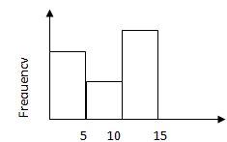
Numerosity Reduction
Data are replaced or estimated by alternative, smaller data representation
Eg Histogram
{2, 2, 5, 5, 10, 10, 12, 12, 12, 12, 12}
{3,10,12}
Now use the mid point
Reduce the data set
(2+2+5+5)/4=3
(12+12+12+12+12)/5=12
(10+10)/2=10

Slide 24
Data Discretization and Concept Hierarchy
Data discretization can be used to reduce the number of values for a given continuous attribute by dividing the range of the attributes into intervals
Interval labels can then be used to replace actual data values
Supervised discretization (uses class information) vs. unsupervised
Discretization can be performed recursively on an attribute to provide hierarchical partitioning of attribute values, called concept hierarchy
Concept hierarchies can be used to reduce the data by collecting and replacing low level concepts (eg Age) with higher level concepts (eg youth, middle_aged, adult)

Slide 25
Concept Hierarchy Generation for Numerical Data
Binning Method
unsupervised
Histogram Analysis
unsupervised
Clustering
unsupervised
Entropy Based Discretization
supervised

Slide 26
Concept Hierarchy Generation for Numerical Data…
Entropy based descretization
Given a set of samples S, if S is partitioned into two intervals S₁ and S₂ using boundary T, the information gain after partitioning is
Entropy is calculated based on class distribution of the samples in the set. Given m classes, the entropy of S₁ is
where p_{i} is the probability of class i in S₁
The boundary that minimizes the entropy function over all possible boundaries is selected as a binary discretization
The process is recursively applied to partitions obtained until some stopping criterion is met
Such a boundary may reduce data size and improve classification accuracy

Slide 27
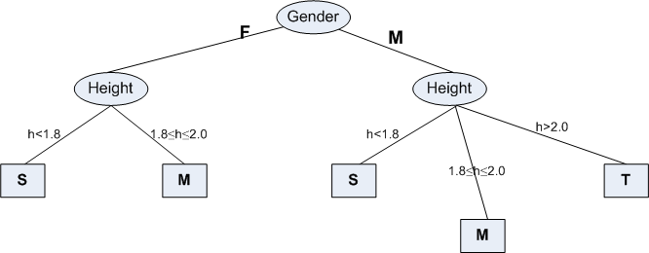
Concept Hierarchy Generation for Numerical Data…
Entropy based descretization…
Gender | Height | Class
F | <1.8 | S
M | 1.8 – 2.0 | M
F | 1.8 – 2.0 | M
F | 1.8 – 2.0 | M
F | <1.8 | S
M | 1.8 – 2.0 | M
F | >2.0 | S
M | >2.0 | S
M | 1.8 – 2.0 | T
M | 1.8 – 2.0 | T

Slide 28
Concept Hierarchy Generation for Categorical Data…
Specification of a partial/total ordering of attributes explicitly at the schema level by users or experts
Example
Ward No < Municiplity < State < Country

Slide 29
Data Mining Primitives
A data mining task can be specified in the form of a data mining query, which is input to the data mining system
A data mining query is defined in terms of the following primitives
Task relevant data
Types of knowledge to be mined
Background knowledge
Pattern interestingness measures
Visualization/presentation of discovered patterns

Slide 30
Data mining primitives…
Task-relevant data
This is the database portion to be investigated
Attributes of interest (eg name is not relevant in most of the knowledge discovering cases)
For example, suppose that you are a manager of AllElectronics in charge of sales in the United States and Canada. In particular, you would like to study the buying trends of customers in Canada. Rather than mining on the entire database, you can specify that only the data relating to customer purchases in Canada need be retrieved

Slide 31
Data mining primitives…
The kinds of knowledge to be mined
This specifies the data mining functions to be performed, such as characterization, discrimination, association, classification, clustering, or evolution analysis
For instance, if studying the buying habits of customers in Canada, you may choose to mine associations between customer profiles and the items that these customers like to buy.
age(X; 30-39) ^ income(X; 40 -50K) -> buys(X; "V CR")

Slide 32
Data mining primitives…
Background knowledge
Users can specify background knowledge, or knowledge about the domain to be mined
It is the domain of the information to be mined
allow data to be mined at multiple levels of abstraction
Types
Schema Hierarchies (Eg:- Street < City < Country)
Set Grouping Hierarchy (Eg:- 20-29→ Youth, 30-39 →Adult)
Concept Hierarchy

Slide 33
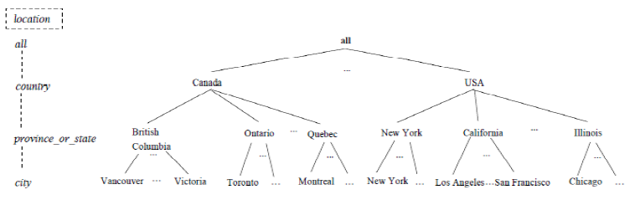
Data mining primitives…
Concept Hierarchy

Slide 34
Data mining primitives…
Interestingness measures
These functions are used to separate uninteresting patterns from knowledge
Different kinds of knowledge may have different interestingness measures
Support and confidence

Slide 35
Data mining primitives…
Presentation and visualization of discovered patterns
This refers to the form in which discovered patterns are to be displayed
Users can choose from different forms for knowledge presentation, such as rules, tables, charts, graphs, decision trees, and cubes

Slide 36
End of Session

